Slide 1
Hibernate
Nguyen Duc Kien

Slide 2
Table of content – Part 1
The meaning of hibernate framework
Difference between hibernate and JDBC
Hibernate interface : Session, Session Factory, Transaction,..
The meaning of ORM
The meaning of JPA
Annotation in mapping entity (importance pieces)

Slide 3
https://stackjava.com/hibernate/series-hibernate-phan-1-gioi-thieu-ve-hibernate-framework.html
https://stackjava.com/uncategorized/orm-la-gi-tong-quan-ve-orm-framework.html
https://www.geeksforgeeks.org/difference-between-jdbc-and-hibernate-in-java/
https://www.javatpoint.com/hibernate-tutorial
https://dzone.com/articles/all-jpa-annotations-mapping-annotations
https://www.java2novice.com/hibernate/session-factory/
https://www.geeksforgeeks.org/introduction-to-hibernate-framework/
example
https://www.journaldev.com/7655/spring-orm-example-jpa-hibernate-transaction
!importance
https://www.infoworld.com/article/2072999/get-started-with-hibernate.html?page=2
làm rõ jpa và orm
https://medium.com/oceanize-geeks/the-active-record-and-data-mappers-of-orm-pattern-eefb8262b7bb\
https://dzone.com/articles/what-is-the-difference-between-hibernate-and-sprin-1
hibernate
https://www.geeksforgeeks.org/hibernate-architecture/
https://www.youtube.com/watch?v=GX3D0OIFOhE

Slide 4

Hibernate framework
Hibernate is a Java framework that simplifies the development of Java application to interact with the database.
It provides some abstraction layer, meaning that the programmer does not have to worry about the implementations, Hibernate does the implementations for you internally like Establishing a connection with the database, writing query to perform CRUD operations etc.
It is an open source, lightweight, ORM (Object Relational Mapping) tool. Hibernate implements the specifications of JPA (Java Persistence API) for data persistence.

Slide 5
Open Source means:
Hibernate framework is available for everyone without any cost.
The source code of Hibernate is also available on the Internet and we can also modify the code.
Light-weight means:
Hibernate is less in size means the installation package is not big is size.
Hibernate does not require any heavy container for execution.
It does not require POJO (plain old java object) and POJI (plain old java interface) model programming.
Hibernate can be used alone or we can use Hibernate with other java technology and framework.
Non-invasive means:
The classes of Hibernate application development are loosely coupled classes with respect to Hibernate API i.e. Hibernate class need not implement hibernate API interfaces and need not extend from Hibernate API classes.

Slide 6
Difference between hibernate and JDBC
JDBC
Hibernate
In JDBC, one needs to write code to map the object model’s data representation to the schema of the relational model.
JDBC enables developers to create queries and update data to a relational database using the Structured Query Language (SQL)
JDBC code needs to be written in a try catch block as it throws checked exception(SQLexception)
JDBC is database dependent i.e. one needs to write different codes for different database
Creating associations between relations is quite hard in JDBC.
Hibernate maps the object model’s data to the schema of the database itself with the help of annotations.
Hibernate uses HQL (Hibernate Query Language) which is similar to SQL but understands object-oriented concepts like inheritance, association etc.
Whereas Hibernate manages the exceptions itself by marking them as unchecked.
Whereas Hibernate is database independent and same code can work for many databases with minor changes
Associations like one-to-one, one-to-many, many-to-one, and many-to-many can be acquired easily with the help of annotations

Slide 7
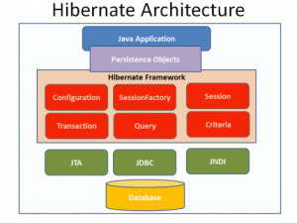
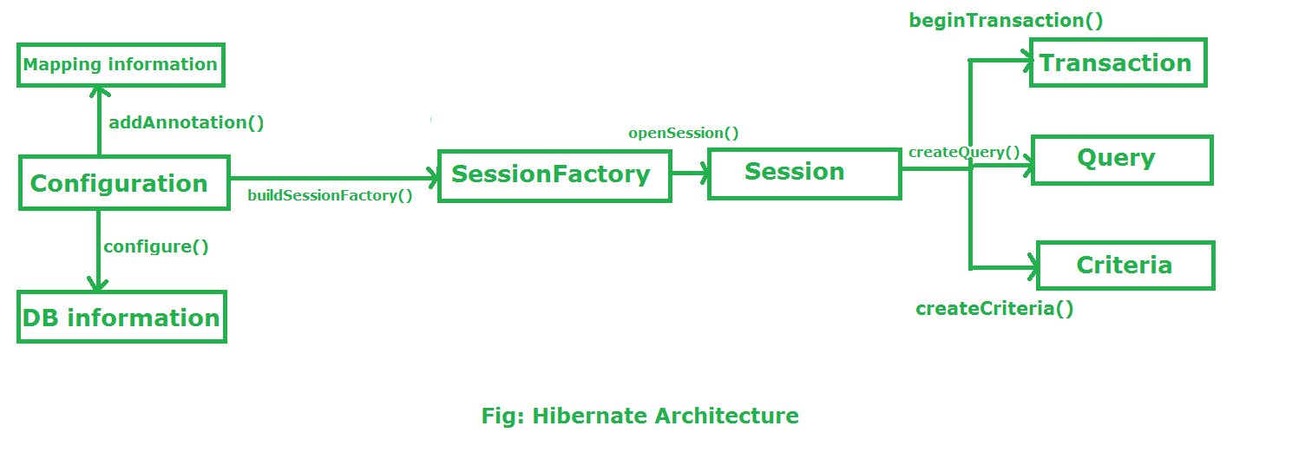
Hibernate framework include

Slide 8
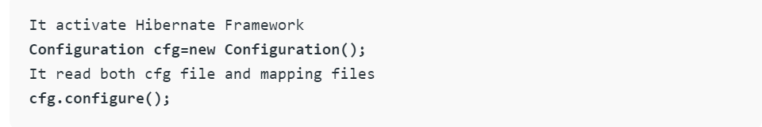
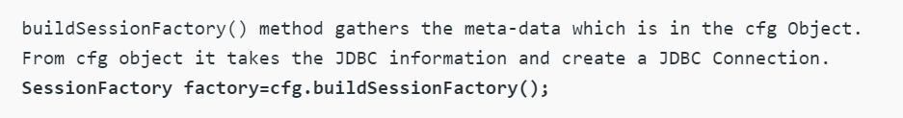
Configuration:
Configuration is a class which is present in org.hibernate.cfg package. It activates Hibernate framework. It reads both configuration file and mapping files.
It checks whether the config file is syntactically correct or not.
If the config file is not valid then it will throw an exception. If it is valid then it creates a meta-data in memory and returns the meta-data to object to represent the config file.
SessionFactory :
SessionFactory is an Interface which is present in org.hibernate package and it is used to create Session Object.
It is immutable and thread-safe in nature

Slide 9
Session:
Session is an interface which is present in org.hibernate package. Session object is created based upon SessionFactory object i.e. factory.
It opens the Connection/Session with Database software through Hibernate Framework..
Session object is used to perform CRUD operations
Transaction :
Transaction object is used whenever we perform any operation and based upon that operation there is some change in database.
Transaction object is used to give the instruction to the database to make the changes that happen because of operation as a permanent by using commit() method.

Slide 10
Query:
Query is an interface that present inside org.hibernate package.
A Query instance is obtained by calling Session.createQuery().
This interface exposes some extra functionality beyond that provided by Session.iterate() and Session.find():
A particular page of the result set may be selected by calling setMaxResults(), setFirstResult().
Named query parameters may be used.
Criteria:
Criteria is a simplified API for retrieving entities by composing Criterion objects.
The Session is a factory for Criteria. Criterion instances are usually obtained via the factory methods on Restrictions.

Slide 11
Integrating Spring Framework with Hibernate Framework
Hibernate is a framework that does a JPA reinstall
In hibernate, we declare the database information in the hibernate.cfg.xml file.
If we integrate Hibernate with Spring, we don't need to create hibernate.cfg.xml file, we can provide all information in spring config file.
Integrating Hibernate with Spring also helps us to reduce a lot of code, and do not need to do many steps such as creating Configuration, BuildSessionfactory, Session, creating and committing Transaction ...

Slide 12
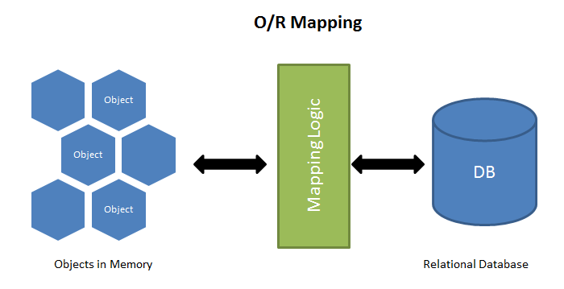
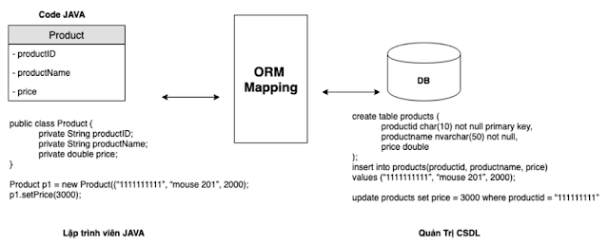
What is ORM
Object-relational mapping (ORM, O/RM, and O/R mapping tool) in computer science is a programming technique for converting data between incompatible type systems using object-oriented programming languages. This creates, in effect, a "virtual object database" that can be used from within the programming language. There are both free and commercial packages available that perform object-relational mapping, although some programmers to construct their own ORM tools. - from wikipedia
In simple meaning :
ORM is a programming technique that helps to map data records in a database management system to the type of objects defined in classes - a common concept used in all modern languages ​​these days. such as: Java, PHP, Ruby.

Slide 13
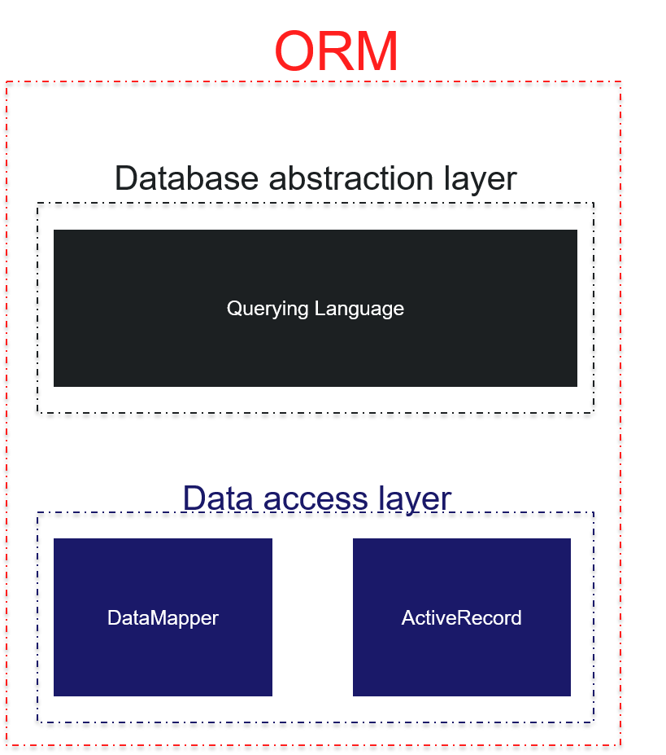
Two design types of ORM
Active Record pattern: The Web’s Favorite ORM
Data Mapper pattern

Slide 14
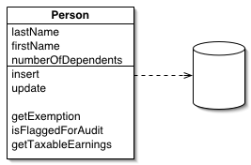
Active Record pattern
The active record pattern is an approach to accessing data in a database. A database table or view is wrapped into a class. Thus, an object instance is tied to a single row in the table. After creation of an object, a new row is added to the table upon save. Any object loaded gets its information from the database. When an object is updated the corresponding row in the table is also updated. The wrapper class implements accessor methods or properties for each column in the table or view.
Advantage
Simple. Because of how tightly matched the records in your database and the objects in your system are conceptually, it’s really easy to pick up a project, examine its database schema, and have a strong sense of what the project is doing. What makes this great is that the ORM layers have a minimal amount of indirection. What you see in the database or objects is likely what exists in the other.
Easy to understand. This flows directly out of the simplicity, but you’ll also probably have a pretty intuitive understanding of how you can work with this system even if you’ve never had the least exposure to an ORM before. Its simplicity is easy.

Slide 15
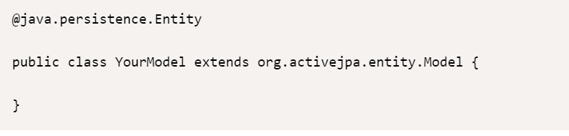
Example of active record

Slide 16
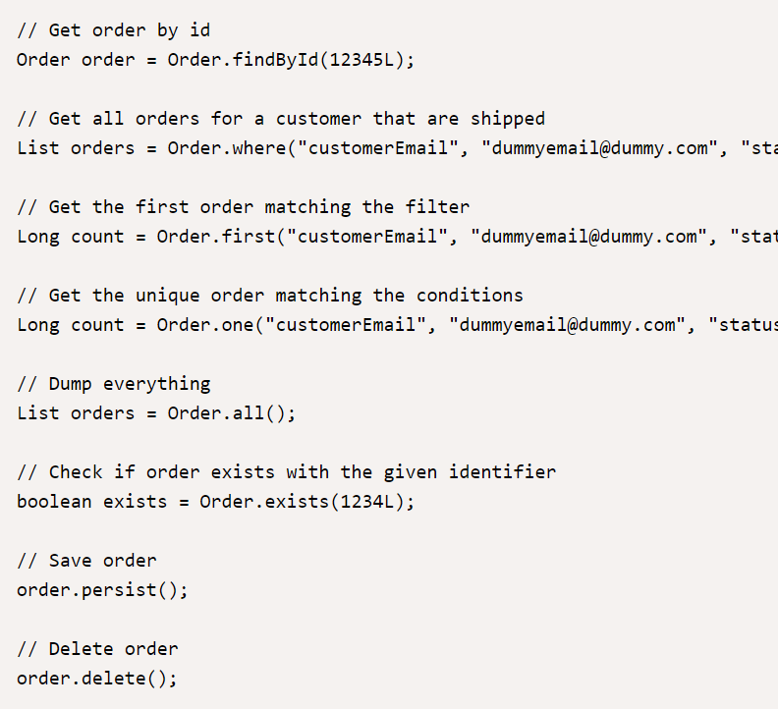

Slide 17
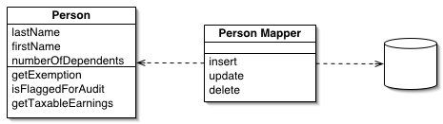
Data Mapper pattern
A Data Mapper is a Data Access Layer that performs bidirectional transfers of data between a persistent data store (often a relational database) and an in memory data representation (the domain layer). The goal of the pattern is to keep the in memory representation and the persistent data store independent of each other and the data mapper itself. The layer is composed of one or more mappers (or Data Access Objects), performing the data transfer. Mapper implementations vary in scope. Generic mappers will handle many different domain entity types, dedicated mappers will handle one or a few.
Advantage
Allows for greater flexibility between domain and database. As we mentioned above, one of the prototypical reasons that you’ll want to use a data mapper is that you as the application architect do not actually have final say on the database scheme. Where you’ve got a historical database, or a new database with an unfriendly gatekeeper, the data mapper pattern allows you to hide the ways in which you database isn’t an ideal way to think about your domain behind the whole data-mapping layer.
Can be much more performance. Similarly, because you do have a layer of abstraction and indirection between your domain objects and your database, there’s a good possibility that you can have the data mapper make more efficient use of the database than a naive active record implementation would allow.

Slide 18
What is JPA
The Java Persistence API (JPA) is the Java standard for mapping Java objects to a relational database.
JPA is one possible approach to ORM. Via JPA, the developer can map, store, update, and retrieve data from relational databases to Java objects.
JPA can be used in Java-EE and Java-SE applications. JPA is a specification and several implementations are available.

Slide 19
For simple way to understand JPA
JPA include interface and must implement to use
JPA just a specification of ORM
When a project implement JPA, it can be run, switch to every ORM tools like : Hibernate, EclipseLink, iBatis,…

Slide 20
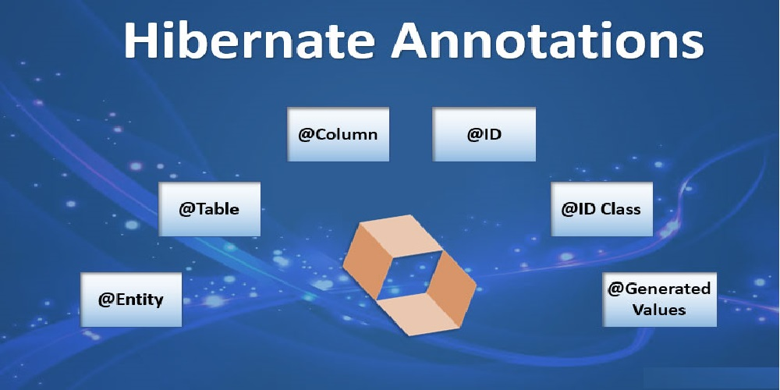

Slide 21
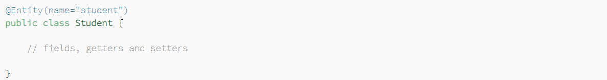
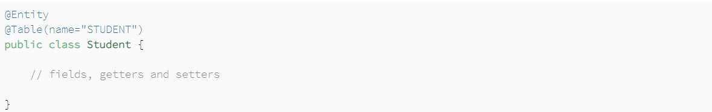
@Entity Entities in JPA are nothing but POJOs (Plain Old Java 0bject) representing data that can be persisted to the database. An entity represents a table stored in a database. Every instance of an entity represents a row in the table.
@Table In most cases, the name of the table in the database and the name of the entity will not be the same. In these cases, we can specify the table name using the @Table annotation. If we do not use the @Table annotation, the name of the entity will be considered the name of the table.

Slide 22
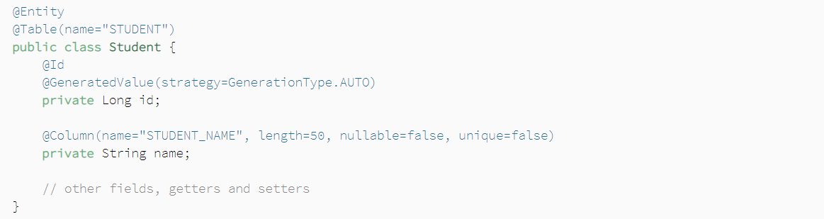
@Column Just like the @Table annotation, we can use the @Column annotation to mention the details of a column in the table. The @Column annotation has many elements such as name, length, nullable, and unique.
The name element specifies the name of the column in the table.
The length element specifies its length.
The nullable element specifies whether the column is nullable or not
The unique element specifies whether the column is unique.
If we don't specify this annotation, the name of the field will be considered the name of the column in the table.

Slide 23
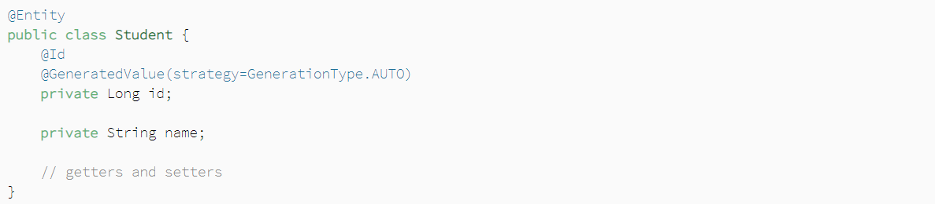
@Id Each JPA entity must have a primary key which uniquely identifies it. The @Id annotation defines the primary key. We can generate the identifiers in different ways which are specified by the @GeneratedValue annotation.
@GeneratedValue We can choose from four id generation strategies with the strategy element. The value can be AUTO, TABLE, SEQUENCE, or IDENTITY
AUTO: Hibernate selects the generation strategy based on the used dialect,
IDENTITY: Hibernate relies on an auto-incremented database column to generate the primary key,
SEQUENCE: Hibernate requests the primary key value from a database sequence,
TABLE: Hibernate uses a database table to simulate a sequence.

Slide 24
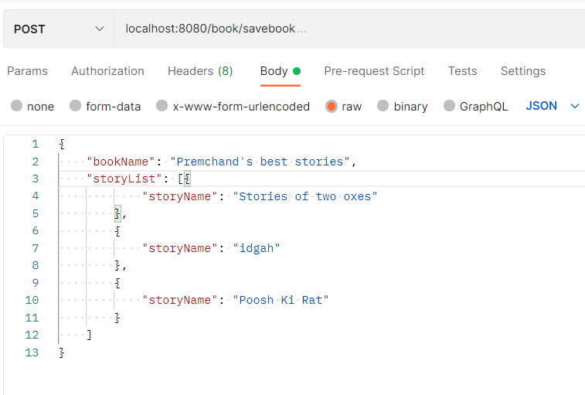
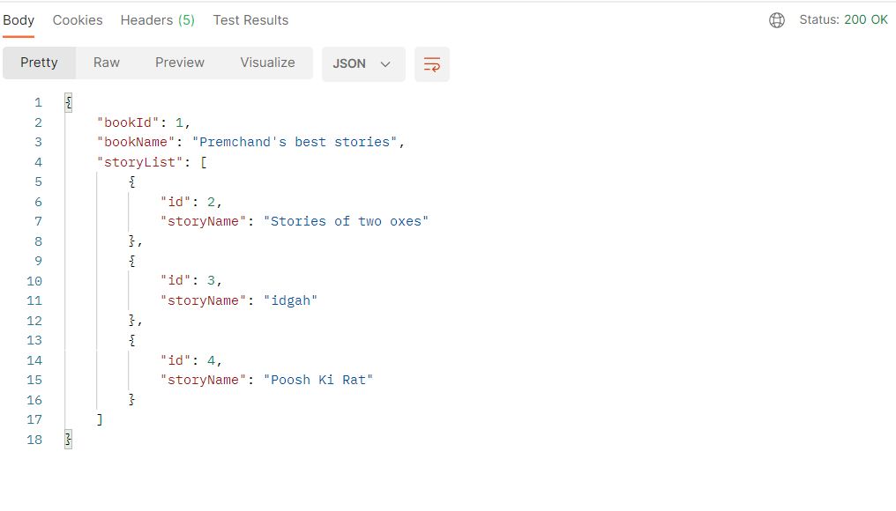
The Auto Strategy
ObjectDB maintains a special global number generator for every database. This number generator is used to generate automatic object IDs for entity objects with no primary key fields defined.
AUTO is the default strategy.
INPUT
OUTPUT

Slide 25
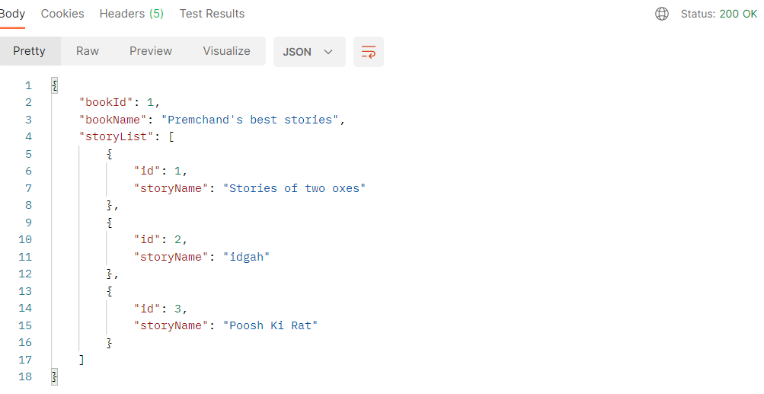
The Identity Strategy
The IDENTITY strategy also generates an automatic value during commit for every new entity object.
The difference is that a separate identity generator is managed per type hierarchy, so generated values are unique only per type hierarchy.
INPUT
OUTPUT

Slide 26
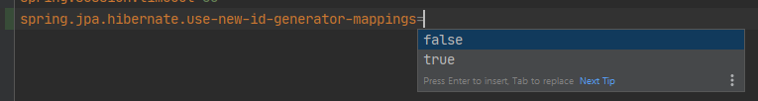
The Table Strategy
The TABLE strategy will need to create a table to store the ID generated value.
By default, if we use Hibernate as the implementation of JPA, it would be generated a table named “hibernate_sequences”.
There are 2 ways for definition of this table using application.properties file.

Slide 27
If we set generator_mapping = true, the hierarchy of hibernate_sequences will be created as:
If we set generator_mapping = false, it would like: (Not prefer in MySQL)
1 2 3 4 5 | CREATE TABLE `hibernate_sequences` ( `sequence_name` VARCHAR(255) NOT NULL, `next_val` INT(19), PRIMARY KEY (`sequence_name`) ) ENGINE=InnoDB DEFAULT CHARSET=utf8;
1 2 3 4 5 | CREATE TABLE `hibernate_sequences` ( `sequence_name` VARCHAR(255) NOT NULL, `sequence_next_hi_value` INT(11), PRIMARY KEY (`sequence_name`) ) ENGINE=InnoDB DEFAULT CHARSET=utf8;

Slide 28
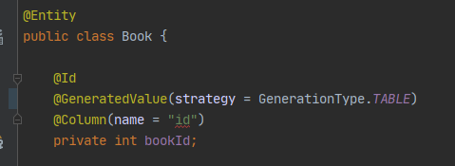
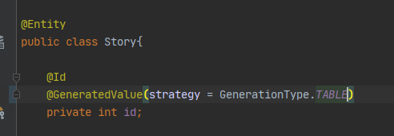
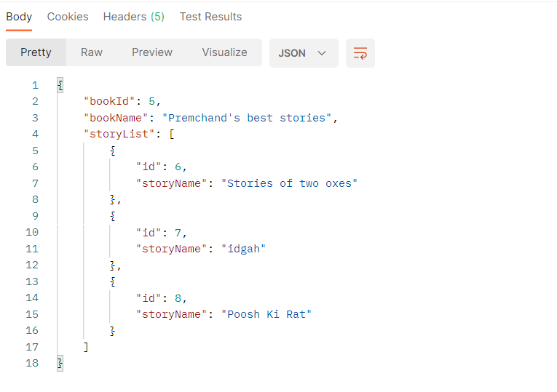
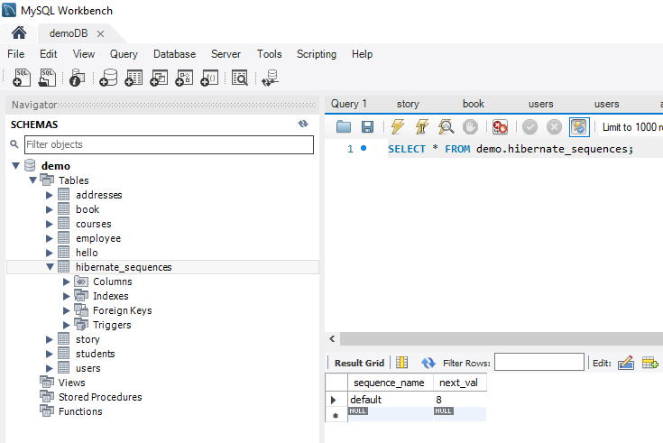
The GenerateValue will follow to the Hibernate_Sequences table

Slide 29
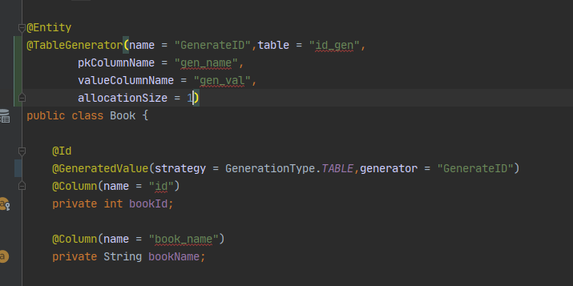
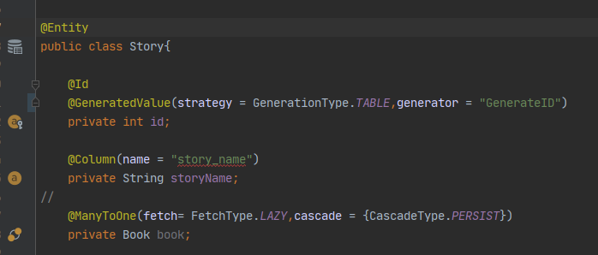
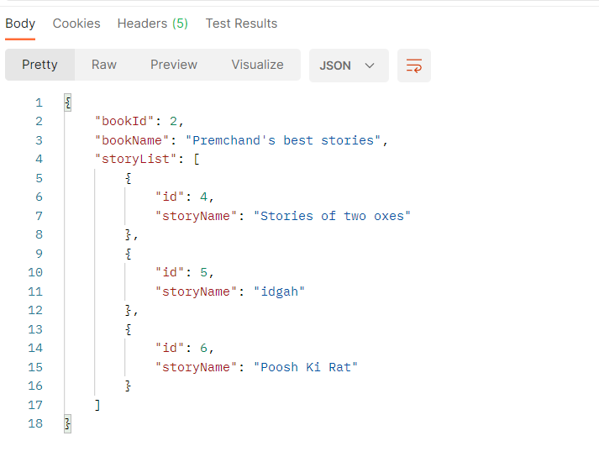
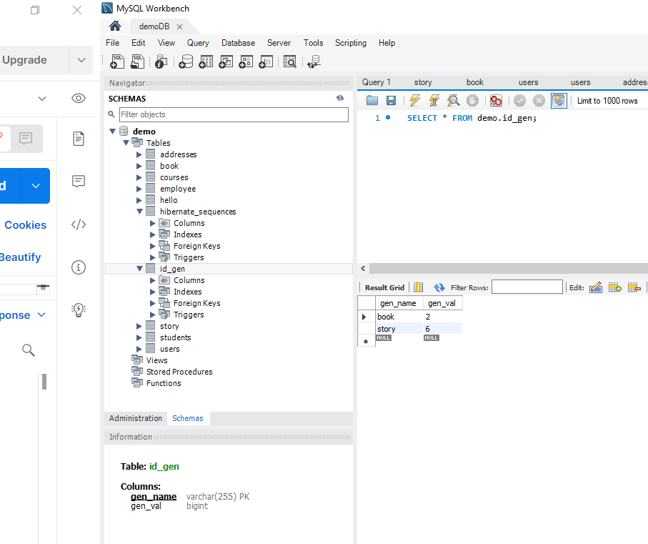
We could also customize Hibernate_Sequences table by using @TableGenerator annotation

Slide 30
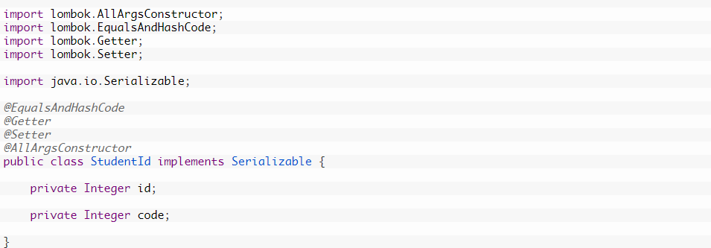
@IdClass Specifies a composite primary key class that is mapped to multiple fields or properties of the entity. The names of the fields or properties in the primary key class and the primary key fields or properties of the entity must correspond and their types must be the same

Slide 31
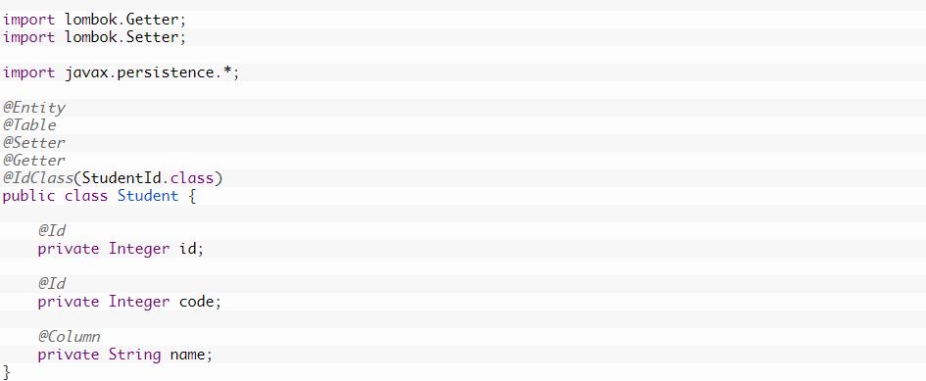

Slide 32
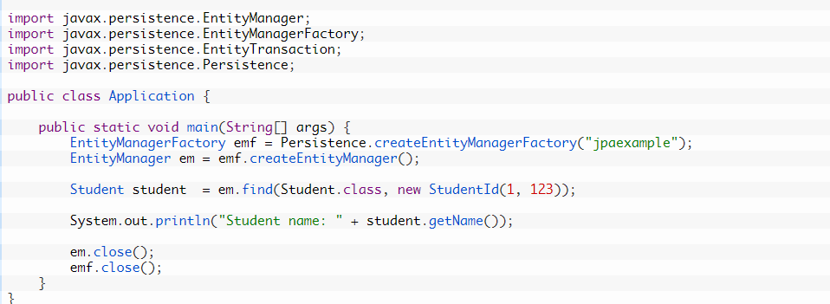

Slide 33
Table of content – part 2
Relationship in Hibernate in Spring JPA
Derived Query Methods
Custom Queries using @Query Annotation
Named Queries
Sorting Query Results
Reference: https://attacomsian.com/topics/spring-data-jpa
Code: https://github.com/duckiennguyen3105/springjpademo

Slide 34
Relationship in Spring Hibernate
1

Slide 35
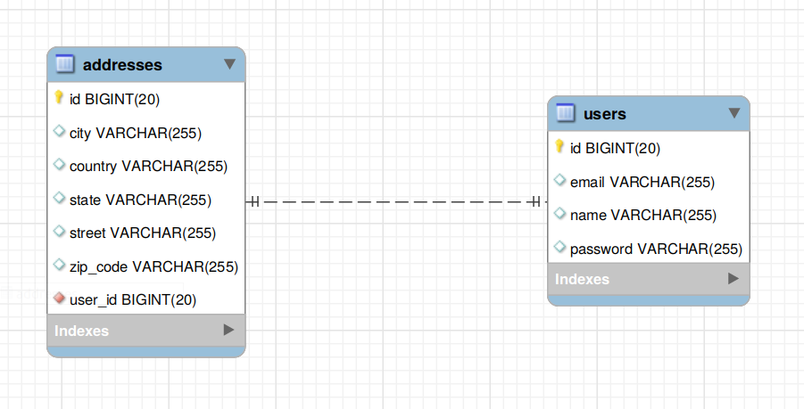
One to one annotation
A one-to-one relationship refers to the relationship between two entities (tables) A and B in which only one element/row of A may only be linked to one element/row of B, and vice versa.

Slide 36
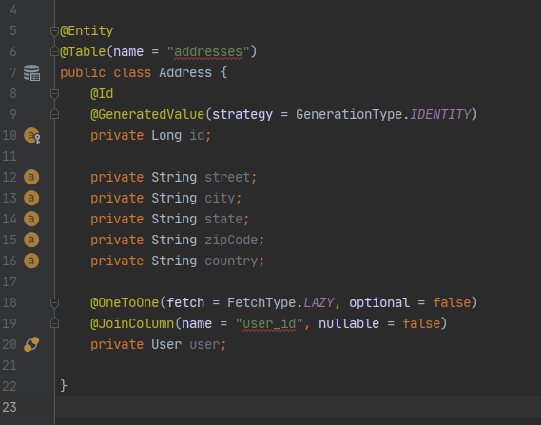
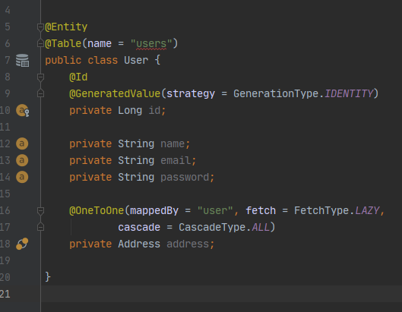
Example

Slide 37
Annotation explain
@OneToOne Annotation is using for declaring one-to-one relationship between two entities. It has following parameters:
fetch - Defines a strategy for fetching data from the database. EAGER is set to fetch by default.
<xác định chiến lược truy xuất dữ liệu từ cơ sở dữ liệu. Mặc định là EAGER >
FetchType.LAZY: data won't be initialized and loaded into a memory until an explicit call is made to it.
FetchType.EAGER: data associating with that object will be initialized at the time and loaded into memory.
cascade - Defines a set of cascadable operations that are applied to the associated entity.
CascadeType.PERSIST: In this cascade operation, if the parent entity save() or persist() then all its related entity will also be save() or persist().
CascadeType.MERGE: related entities are merged when the owning entity is merged.
CascadeType.REMOVE: parent entity is removed then all its related entity will also be removed.
CascadeType.DETACH: parent detached then all its related entity will also be detached.
CascadeType.REFRESH: parent entity is refreshed then all its related entity will also be refreshed.
CascadeType.ALL: above cascade operations can be applied to the entities related to parent entity.

Slide 38
mappedBy (in the parent entity) - Defines the entity that owns the relationship which is the child entity. In this case, addresses is the child entity.
orphanRemoval (in the parent entity) – delete orphaned entities from the database which is no longer attached to its parent.
optional (in the child entity) - Defines whether the relationship is optional. If set to false then a non-null relationship must always exist.
In a bidirectional relationship, we have to specify the @OneToOne annotation in both entities. But only one entity is the owner of the association. Usually, the child entity is one that owns the relationship and the parent entity is the inverse side of the relationship.
@JoinColumn Annotation is used to specify the foreign key column in the owner of the relationship.
name: Defines the name of the foreign key column.
nullable: Defines whether the foreign key column is nullable. By default, it is true. (it’s also have unique, updatable,..)
referencedColumnName: defines the referenced column in parent table.

Slide 39
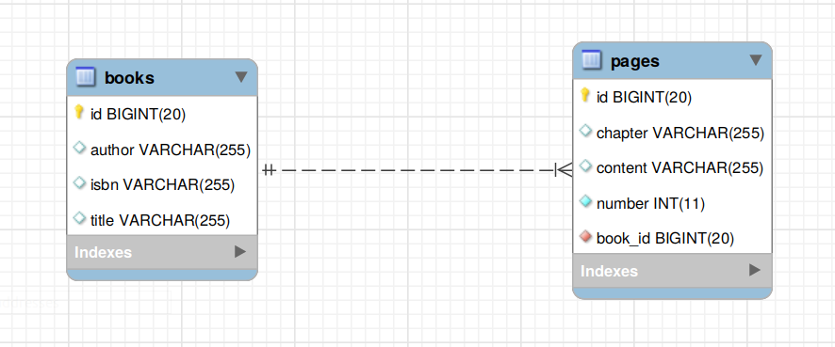
One to many annotation
A one-to-many relationship refers to the relationship between two entities/ tables A and B in which one element/row of A may only be linked to many elements/rows of B, but a member of B is linked to only one element/row of A.
The opposite of one-to-many is many-to-one relationship.

Slide 40
Annotation explain
@OneToMany Annotation is used to define a parent in a relationship between two entities in Spring Data JPA. It has following parameters:
fetch - Defines a strategy for fetching data from the database. EAGER is set to fetch by default.
cascade - Defines a set of cascadable operations that are applied to the associated entity.
mappedBy - Defines the entity that owns the relationship which is the child entity.
orphanRemoval (in the parent entity) – delete orphaned entities from the database which is no longer attached to its parent.

Slide 41
@ManyToOne Annotation is used to define a child in a relationship between two entities in Spring Data JPA. It has following parameters:
fetch - Defines a strategy for fetching data from the database. EAGER is set to fetch by default.
cascade - Defines a set of cascadable operations that are applied to the associated entity.
optional – Defines the compositition of the relationship between 2 entities. Default is true.

Slide 42
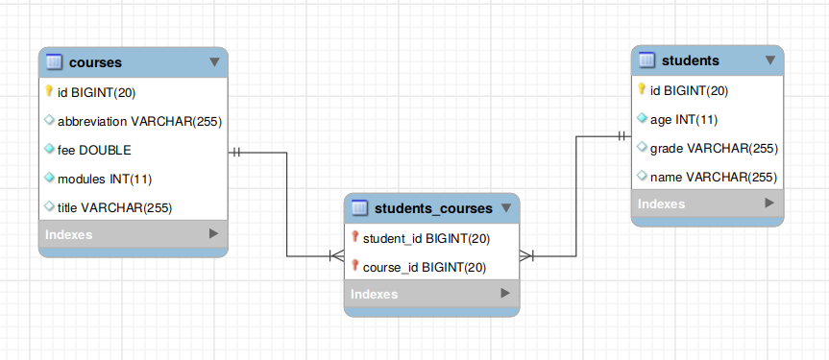
Many to many annotation
A one-to-many relationship refers to the relationship between two entities/ tables A and B in which which one element/row of A may only be associated with many elements/rows of B and vice versa.
To model this relationship in the database, you need to create three tables.

Slide 43
Annotation explain
@ManyToMany annotation is using for declaring many-to-many relationship between two entities. It has following parameters :
fetch - Defines a strategy for fetching data from the database. EAGER is set to fetch by default.
cascade - Defines a set of cascadable operations that are applied to the associated entity.
mappedBy - Defines the entity that owns the relationship which is the child entity.
@JoinTable annotation defines the join table between two entities on the owner's side of the relationship. It has following parameters:
name - The name of the join table.
joinColumns - The foreign key columns of the join table which reference the child table of the entity owning the relationship.
inverseJoinColumns – same with joinColumns but for the entity not owning the relationship.

Slide 44
Hibernate Query Language
2

Slide 45
Criterial & Native Query
3

Slide 46
Thanks!
Any questions ?

